Slide 1
Introduction
SURP 2022 Python Bootcamp
Ohio State Astronomy
Slides by: James W. Johnson

Slide 2
Hello!
We’d like to introduce ourselves
Amanda Ash (2nd year)
Anusha Pai (4th year)
Deb Pathak (1st year)
James Johnson (6th year)
Joy Bhattacharyya (3rd year)
Kaz Gary (1st year)
Liam Dubay (2nd year)
Paarmita Pandey (1st year)

Slide 3
Format
Slides typically take 60-90 minutes
~5-minute break partway through
Strongly advised to not copy example codes – the slides are all online anyway
Spend your mental energy on understanding rather than copying
Each session has a set of exercises
We won’t be collecting/grading anything – this isn’t a course
Material is very condensed to fit into six sessions – mastery of these skills will come over time, even beyond this summer
In the long run, what you get out of this will reflect what you put into it
Notes:
In the past, students have started to notice the usefulness of the concepts covered in the later sessions around July – mind them and you’ll be thanking yourself later.

Slide 4
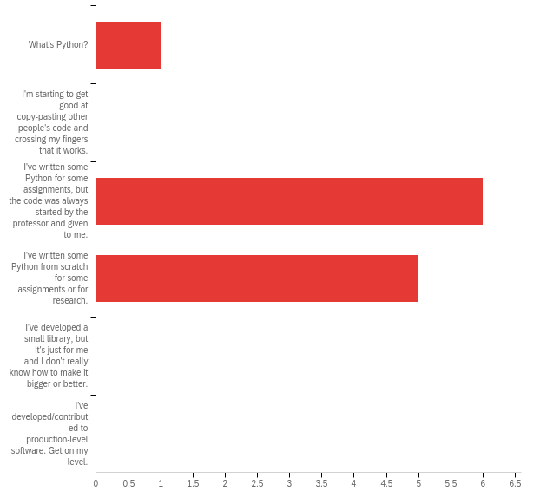
Survey Responses
Q1: How would you describe your skill level in Python?
A wide range of skills, but mostly new to Python
We’re aiming to get you up to the second-to-last option

Slide 5
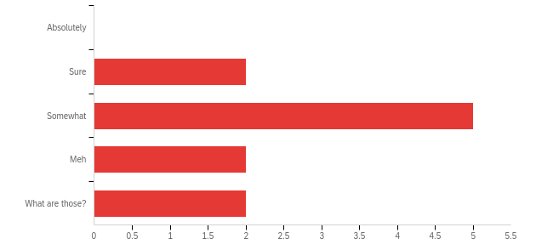
Survey Responses
Q2: Are you comfortable with if/else conditions, for- and while-loops, and def statements?
A wide range of skills in functional programming

Slide 6
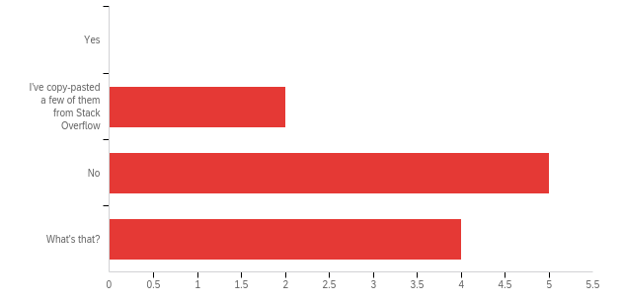
Survey Responses
Q3: Have you ever written a class?
Most of you are new to classes
This will be the focus of sessions 4 and 5

Slide 7
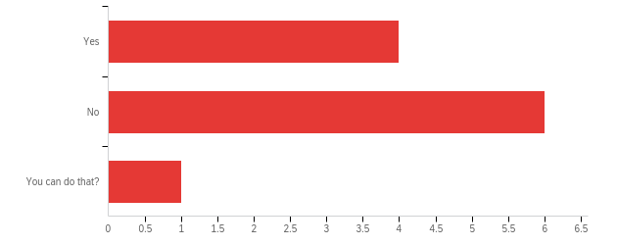
Survey Responses
Q4: Do you know how to, or have you already imported your own code from another file?
Some of you have, some of you haven’t

Slide 8
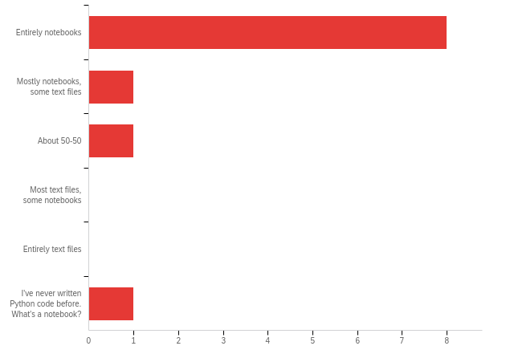
Survey Responses
Q5: Do you write code in text files or jupyter notebooks (or some equivalent)?
Mostly notebooks, but a few of you have worked in text files
When you’ve built up a large code base for a project, they serve different purposes
Notes:
Files – code that you doubt you’ll make many changes to, or the kind of code that you want to import into a notebook. Notebooks – code that produces figures, code that might change a lot, or single-use code.

Slide 9
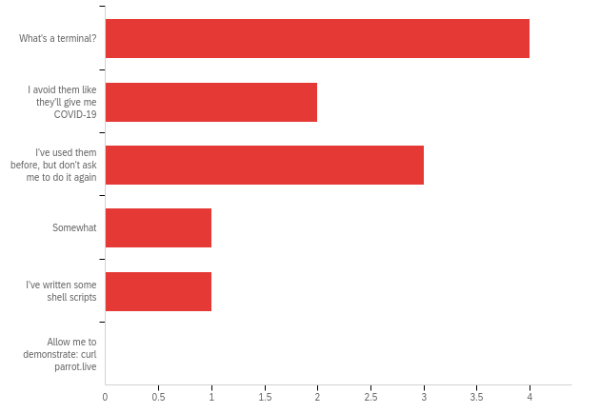
Survey Responses
Q6: How comfortable are you using a terminal/command-line?
Some of you have never used them, others have

Slide 10
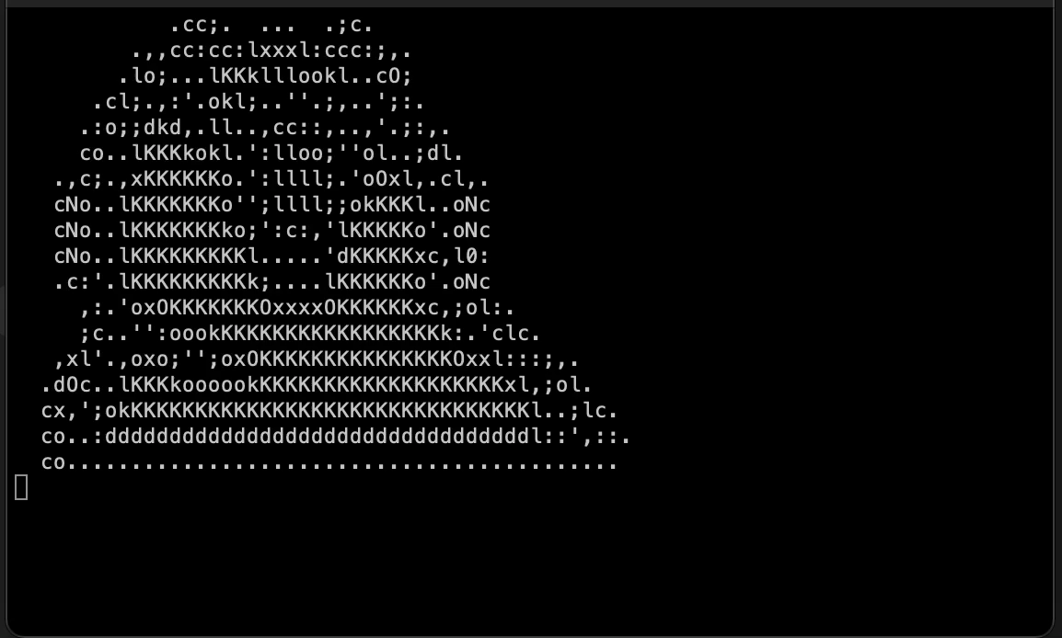
Survey Responses
Q6: How comfortable are you using a terminal/command-line?
Some of you have never used them, others have
Notes:
Party parrot!

Slide 11
Survey Responses
New material:
For many of you: the terminal, object-oriented programming
For about half of you:
How to import your own code from elsewhere in your computer (packaging may be new to some)
Some of the material is either impossible or quite difficult when coding in a notebook. I advise all of you to use this bootcamp as practice for working in text files.
Notes:
I’ll show them how to download the course material after we talk about terminal commands.

Slide 12
Additional Learning Material
Those of you new to Python – we strongly advise going through some of this ahead of Wednesday’s session, which will be a crash course
Python Foundation’s Beginner’s Guide: https://www.python.org/about/gettingstarted/
https://www.learnpython.org/ - There is also an iOS app for this
Codecademy: https://www.codecademy.com/learn/learn-python-3

Slide 13
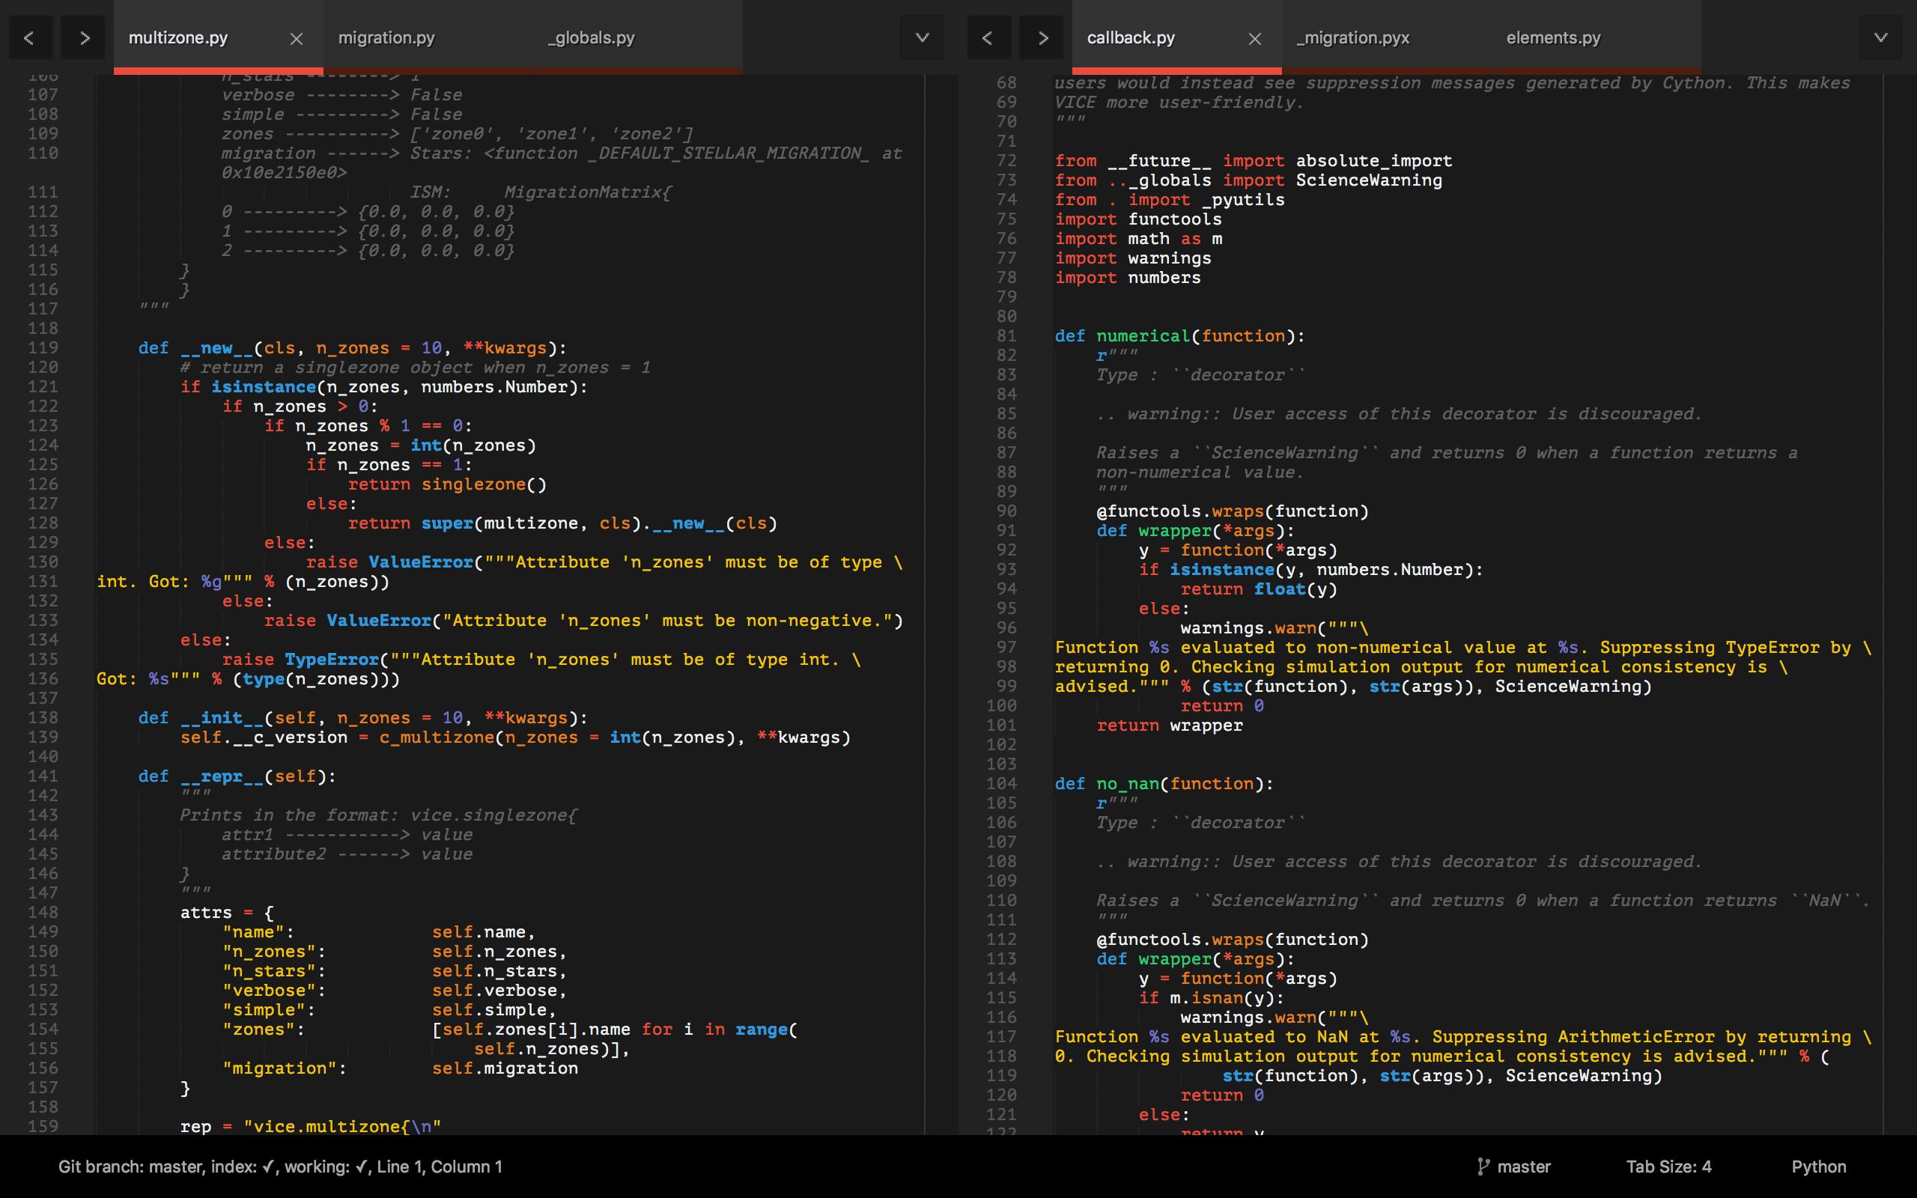
Tools: A Text Editor
Differs from an Integrated Development Environment (IDE) in that IDEs will run the code – all they do is open, create, edit, etc. plain text files
pycharm, spyder
I recommend Sublime Text
https://www.sublimetext.com/

Slide 14
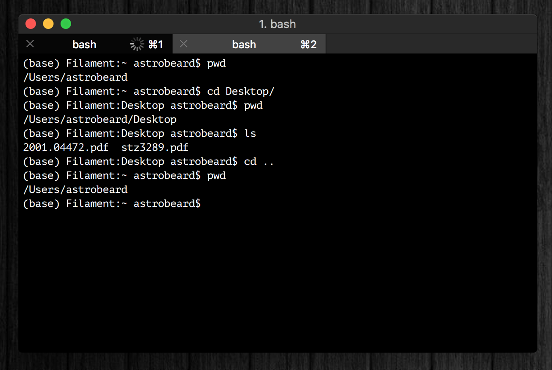
Tools: A Terminal
I recommand iTerm2
Terminal replacement
https://www.iterm2.com/
You should think of a terminal as just a different interface on a Finder window with some extra programs built-in
Tip: you can run python line-by-line in a terminal (python or ipython)

Slide 15
Tools: A Terminal
If you’re running Windows, your terminal will be different than some of the notes and exercises here, unless you take some extra steps at the beginning to set up a bash interpreter.
Talk to us if you need help with this!
Notes:
We’ll sit down at the end of this session with anyone running windows and help them set up the Windows Subsystem for Linux (WSL)

Slide 16
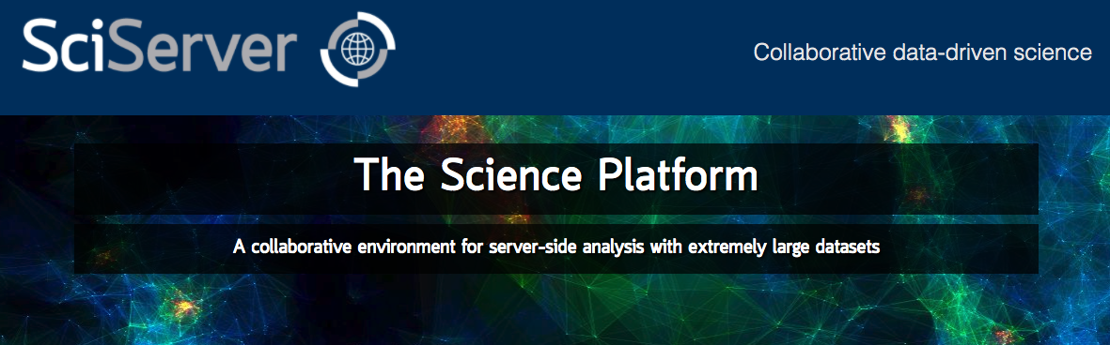
Tools: Cloud Computing
Allows you to run python on a remote server
SciServer is a popular platform across many STEM fields:
https://www.sciserver.org/
In the long run you should choose the tools that you’re most comfortable with

Slide 17
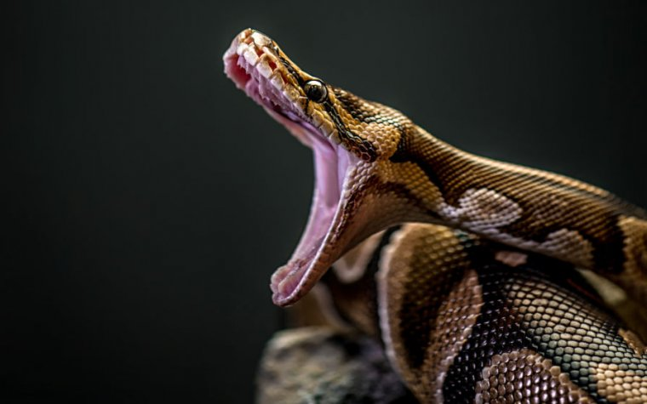
If You Haven’t Already
https://www.anaconda.com/products/individual
This will install Python, Anaconda, and Jupyter Notebooks
Latest version of python: 3.11.3
Most libraries now require >= 3.8
Python 3.7 will be deprecated June 27, 2023
Python 2.7 is deprecated
Talk to us if you need to use it, for now just don’t install that version
Notes:
Emphasize that python 2.7 is deprecated (no longer supported) because the number of stubborn researchers still using it is surprisingly high. If given code that runs on 2.7, they should come talk to us.

Slide 18
Goals
What we’ll aim to cover:
How to use a terminal
Review of the basics: control structures, data types, functions, import, etc.
How to read documentation
Common uses of Anaconda in astronomy
How to import your own code, and how to set up a directory tree to organize it
Classes: how to make new objects
Inheritance and Composition
Some basic software engineering principles (i.e. good habits)

Slide 19
Monday Motivation
Every expert coder was once a novice.
You can’t improve your coding practices without first criticizing what you once thought was great code.
Since we’re not professional developers, scientists have to actively create and foster good coding habits if they want them. Being early career researchers, you have the option to make this decision now. It will only become more difficult to do this.

